Slide 1
Solution Overview
Barry Howard
Principal Systems Engineer

Slide 2





Applications are the business.
62%
of users have increasing expectations of how well digital services should perform.
The busiest bank branch is the mobile app on the 7:15 a.m. train
Education publishing is no longer about text books
The world’s largest taxi company owns no vehicles
A technology business that happens to be in the betting industry.

Slide 3


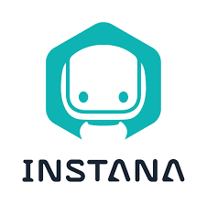




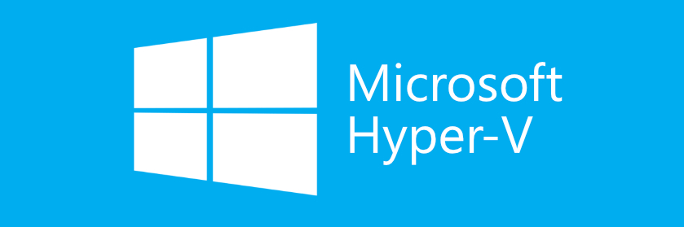

=
Application Performance Management/Observability
(APM)
Application Resource Management
(ARM)
Apps are written
and architected well
Apps are continuously resourced
Performance Assured
Automatically
Efficiently
Sustainably
Notes:
Open: “The alternative is this (Loading…)
It does not matter where your workloads run today, whether they run on-prem, in a container, in AWS or Azure, as long as those resource tiers are misaligned, and application demand remains unpredictable, performance will always suffer and you’ll be left with this (loading…).
So what you need is to make sure these apps are written and architected well, that’s why you’d leverage one of our technology partners like AppDynamics. Then you need to assure that the resources are going to be continuously and constantly delivered to the application when it demands it. What we’ve seen in 10 years of delivering this value to customers is that 9/10th’s of the performance constraints within their environment are resource congestion based that ARM can alleviate then prevent through automation.
Combine these two together and it’s incredibly powerful, you will have continuous application performance assurance regardless of where the workloads run, within the datacenter, hybrid, or multi-cloud.”

Slide 4

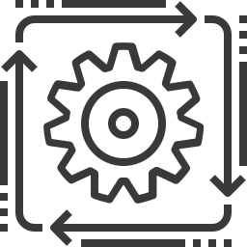
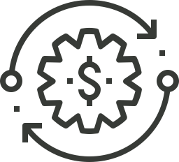

Typical Strategic Priorities
1. Accelerate migration of application and infrastructure services to the cloud with the goal of creating a modern infrastructure at the required standard of efficiency, agility and resiliency.
2. Leveraging automation and optimisation to improve customer experience and reduce downtime
3. Optimise the volume and mix of technology (consumables and data centre technologies), to reduce run cost and free-up capacity for investment/growth.
4. Driving Data Centre Carbon Neutrality & Sustainability
5. Improve the speed and efficiency of change execution through a higher standard of engineering, improved developer productivity and more extensive automation of build, test and release.

Slide 5
Who we are…………………………………………and are not…………..
Application Assurance platform directly tied into the applications and their technology stack in real-time
Fully automated platform driving all resourcing decisions across on-Premise and multi-Cloud environments
Single platform with a single unique analytic across all layers: On-Prem/Cloud/Containers
Fully Bi-Directional API based orchestration
Cloud native platform enabling enterprise scalability
Another basic monitoring & alerting solution providing yet more data to people
Another set of tooling (APM)
Cost reduction platform* (as primary objective)
Custom solution requiring scripting & development to operationalise
Dedicated capacity planning tool
Tool only providing value at one layer or silo

Slide 6


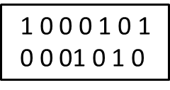


Assure Application Performance WHILE Maximizing Efficiency
Desired State
Define
Control
Drive
Do you risk performance?
“Never!!”
So, you over-allocate (and overpay) to mitigate risk.
Cost is both financial and environmental in its impact

Slide 7
Modern Applications/Compound Challenges
… plus ever-changing demand !!
Beyond Human Scale to Manage
Exponential Components
Real-time
Containers
(100x)
Faster Release Cycles
More complexity
Greater risk
Daily
# Components
Frequency of app changes
Monthly
Cloud
(10x)
Physical (1x)
Virtual
(5x)
Annual
100x
100x
Time
Time
Growing Stakeholders
More Management Tools
+LOB
Tool per team
Communication gaps
Fragmented views
+Dev
# Teams
+CloudOps
# Tools
+NetOps
Uniform
ITOps
5x
6x
Time
Time

Slide 8










Traditional Management Approaches are Inadequate when Dealing with Complexity and Scale
Repeat
Act/Change
Monitor/Alert
Break/Fix
Loop
Modern Application STACK
Application
Management
Decide
Dedup/Analyse
Application Performance Monitoring
PaaS/Container
Management
Container Scheduler
Container Scheduler
Containers/Pods
Containers/Pods
Hybrid Cloud
Management
Siloed teams
Cloud Management
Virtualization Management
SDDC
Tool SPRAWL
Virtualization
BAD SUSTAINABILITY / END user experience
Infrastructure
Management
On Premises
Public Cloud
IMPACTS:
Increased Carbon Footprint
Lost Revenue
Lack of Innovation
Competitive Disadvantage
Customer/Brand Loyalty
Compute
Instances & Tiers
Disparate Data
Storage
Regions, Zones & Discounts
Network
Management
Edge
MANUAL PROCESSES
SDN / SD-WAN
WiFi
INEFFICIENCY

Slide 9

Turbonomic can support your sustainability goals throughout the cloud journey.
Continuous application performance at the lowest cost.
Data Center Optimization
More effective use of existing assets, more effective purchasing for infrastructure growth.
Cloud Migration Planning
App-driven, optimized planning ensures responsible cloud consumption from the start.
Continuous Cloud Optimization
Safely reduce cloud consumption. Continuously consume sustainably as the business grows.
Sustainable
Elastic Cloud
Elastically scale modern apps based on response-time, achieving great digital experiences and elasticity.
Scope 1 & 2
Scope 3
Strategy
Optimize on-prem.
Identify business use cases.
Determine best workloads for migration to cloud.
Pre-Production
Operating first few application workloads, or a non-prod environment in cloud
And/or initiating greenfield app.
Early Production
At least one business-critical application running in Production
Most workloads still yet to move to the public cloud.
Advanced Production
Multiple business-critical applications running in Production—most workloads now reside in the public cloud.
Business Transformation
Cloud-first strategy in place
Business-critical applications leveraging cloud native, PaaS, and other non-differentiating cloud services.
Hybrid Cloud
Multicloud
PaaS/Containers
Notes:
By 2025, 80% of enterprises will shut down their traditional data centers. (Gartner)
Strategy: We are evaluating public cloud providers for their ability to support our business goals.
Pre-Production: We are building cloud capabilities within our organization, having moved the first few application workloads or a non-prod environment; and/or initiating greenfield applications in the cloud.
Early Production: We have at least one business-critical application running in Production in a public cloud—rehosted, replatformed, or greenfield—with a majority of workloads still yet to move.
Advanced Production: We have multiple business-critical applications running in Production in a public cloud—a majority of our workloads now reside in the public cloud. We may have started replatforming applications, making some changes to the application to begin leverage the benefits of cloud, ex. autoscaling or PaaS services.
Business Transformation: Cloud-first strategy in place with business-critical applications leveraging cloud native, PaaS, and other non-differentiating services provided by cloud service providers.

Slide 10

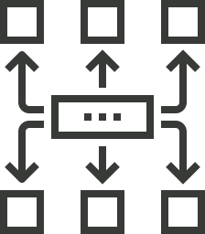


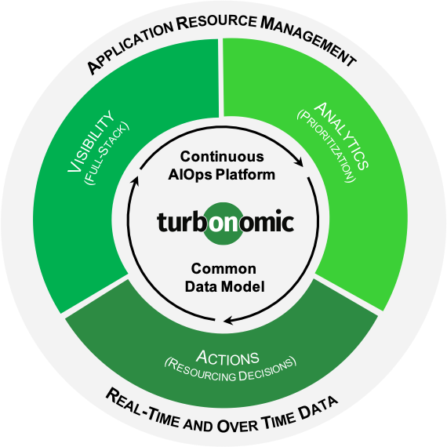
What if you could automatically…
Collect all the data from the entire stack: application, cloud, infrastructure & containers
Manage it all in common data model: understand resources relationship from logical & physical
Visualize data with app-centric lens: enable top-down & bottom-up analysis
Share a common perspective: across LOB, DevOps, cloud, infrastructure and container teams
Trust software to make resourcing decisions: the right actions at the right time
Proven Outcomes
Improve Application Performance and Resilience
Improve Operational Efficiency / Productivity
Reduce Cost / Risk of Digital Transformation Initiatives
Drive Greater Value from Existing H/W and S/W Investments
Accelerate and De-risk Public Cloud / Container Adoption

Slide 11
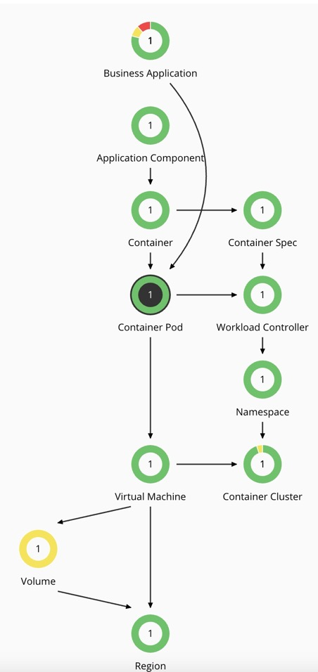
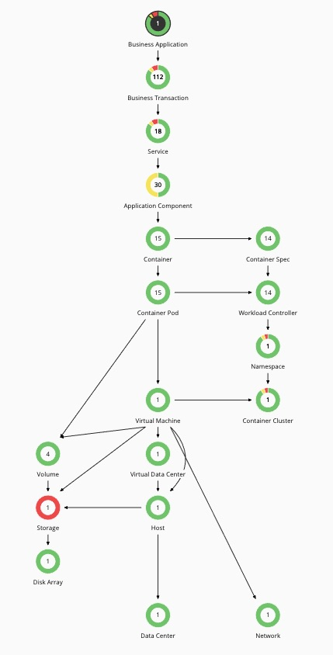
Turbonomic Analytic : A Marketplace of Buyers and Sellers
Buyer & Seller Decisions
Where To Run, Add Resources,
Remove Resources
Market Segmentation Constrains Decisions
Clusters, vLAN, Storage Configuration, Affinity/Anti Affinity, Software Licensing, ….

Slide 12
Turbonomic Analytic : Economic Scheduling Engine Decision Analytics Driven by Pricing (virtual currency)
ms
Delay
Abstracts
Price
QoS Guarantee
0%
Utilisation
100%
0%
Utilisation
100%
Individual buyers and sellers make decisions based on prices, revenue and profitability/ROI
(where to run, add resources, remove resources, change capacity)

Slide 13
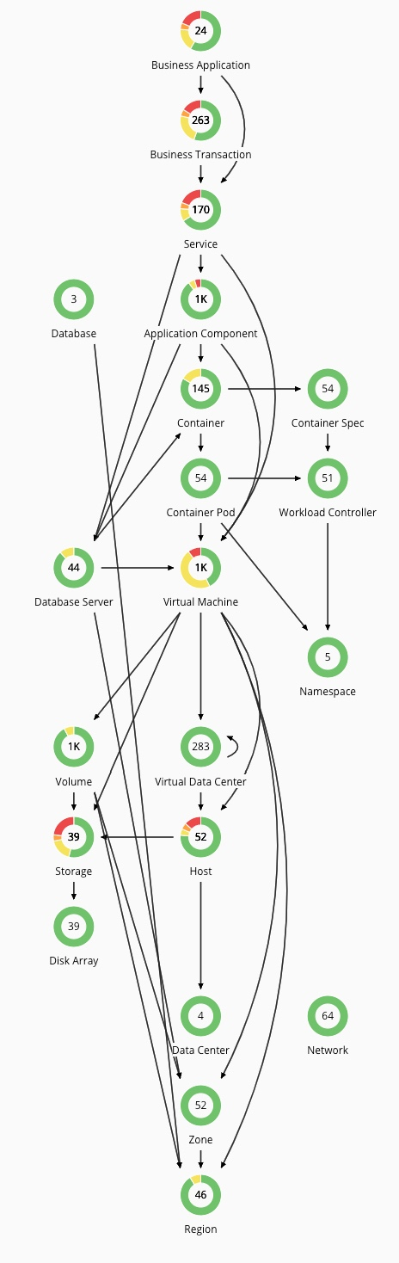
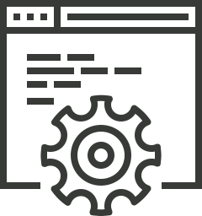




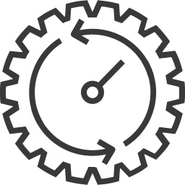

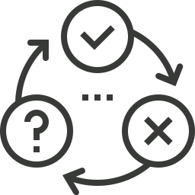



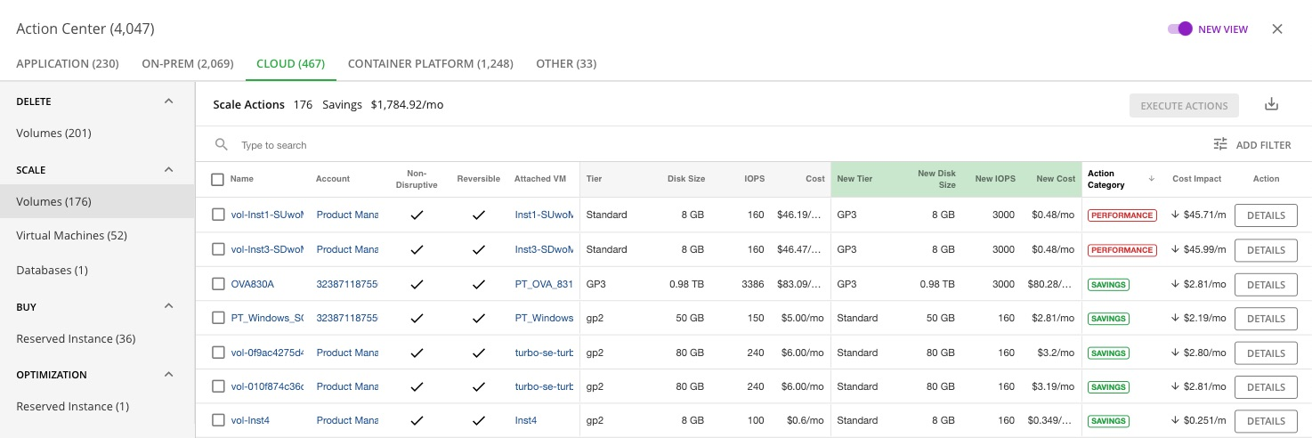

Application Resource Management – Single GUI serving On-Prem, Public Cloud, Hybrid Cloud, Containers at Scale
SETUP
API-Driven Discovery
No agents.
Visibility
App-Infra Resource Relationship Mapping
Analytics
Dynamic Resourcing Decisions
Actions
Executable Trustworthy Actions
TEAMS
Improved Operational Approach
Applications
Provisioning & Orchestration
Containers
Databases
Virtualizations
Public Cloud
Hyperconverged
Compute
Storage
Network
Intelligent Sizing
Continuous Placement
Dynamic Scaling
Buy/Delete/Start/Stop
Scenario Planning
Manually (with a click)
Scheduled
Approval Workflow
Real-Time Automation
LOB/AppDev & DevOps
Continuously assure application performance
Augment teams with AIOps to increase productivity
Drive responsible agility, apps get exactly what they need to perform
Single Source of Truth
SRE & IT Ops/Infra

Slide 14
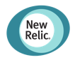
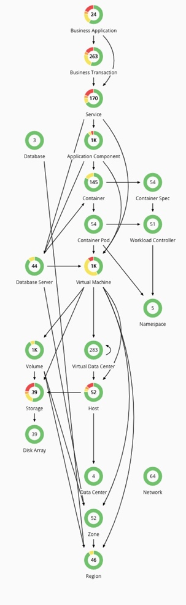




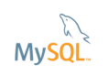
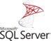
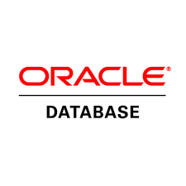




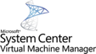


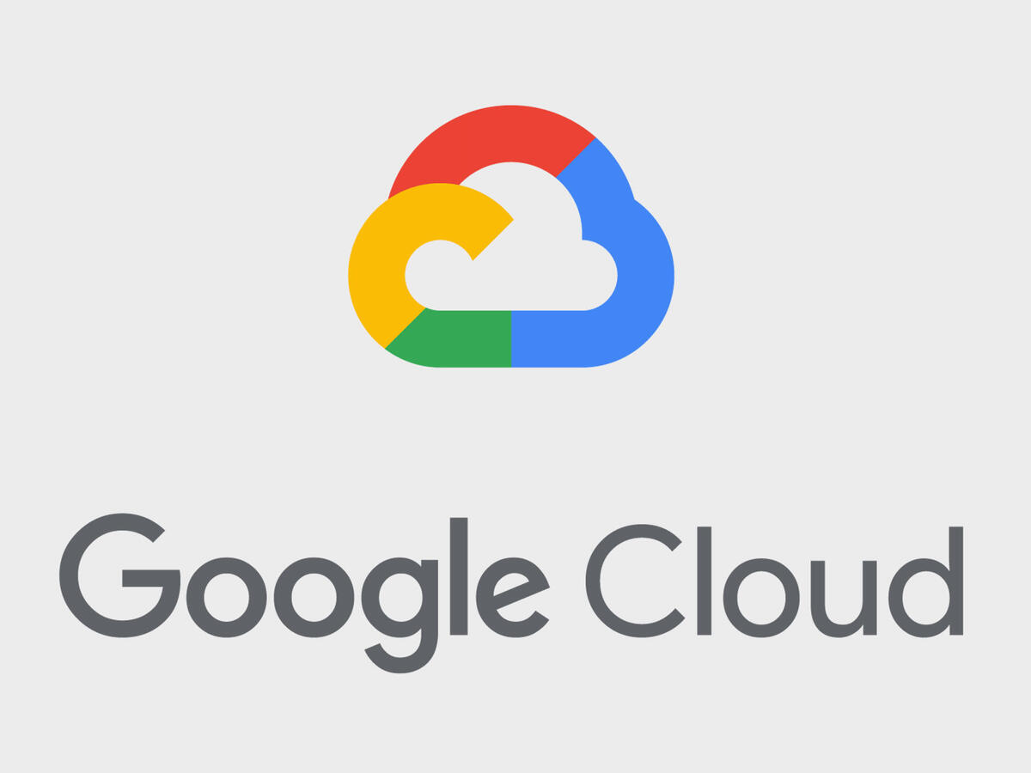




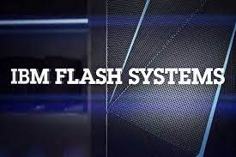


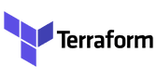
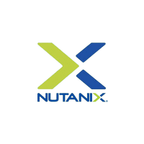
Turbonomic API-Driven Discovery
Applications
Application Insights
Containers
OpenShift
Azure AKS
Amazon EKS
Google GKE
Databases
App Service Plans
Amazon RDS
Azure
SQL Database
Virtualization
RHEV-M
Compute
Elastic Compute (EC2)
Scale Groups (ASG)
Virtual Machine
Scale Sets
Storage
Elastic Block Store
Disk Storage
Network
Provisioning &
Orchestration
CloudFormation
Resource Manager
API Based
-
No Turbonomic Agents Required
Hyperconverged
VDI

Slide 15
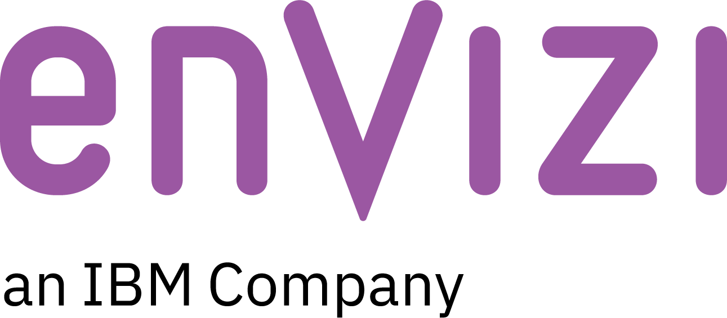
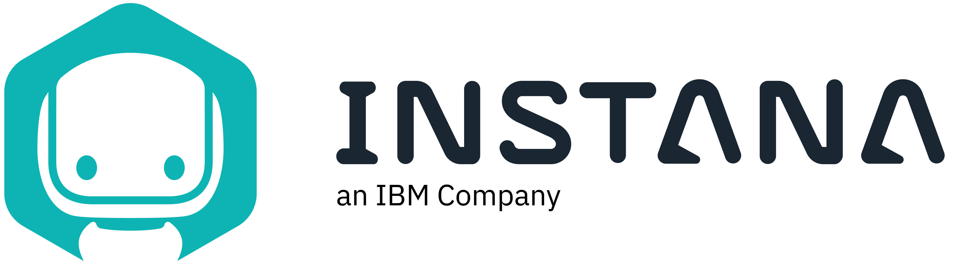



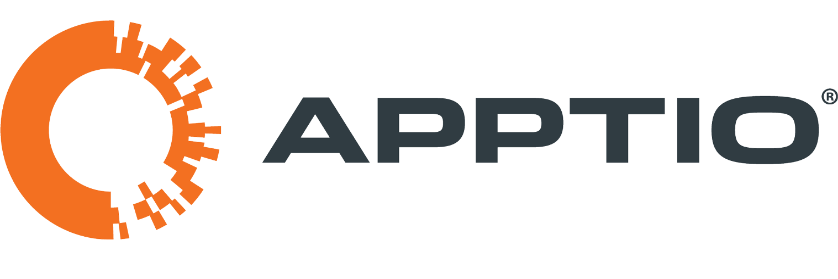


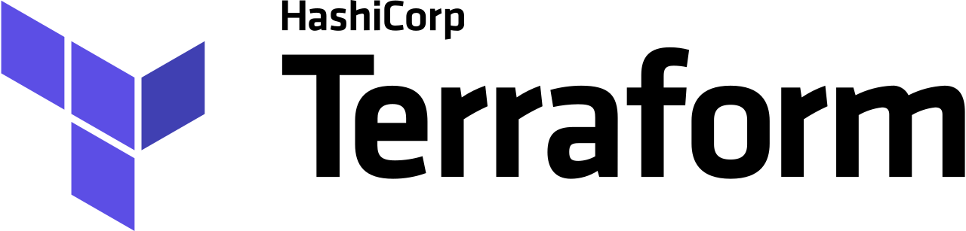
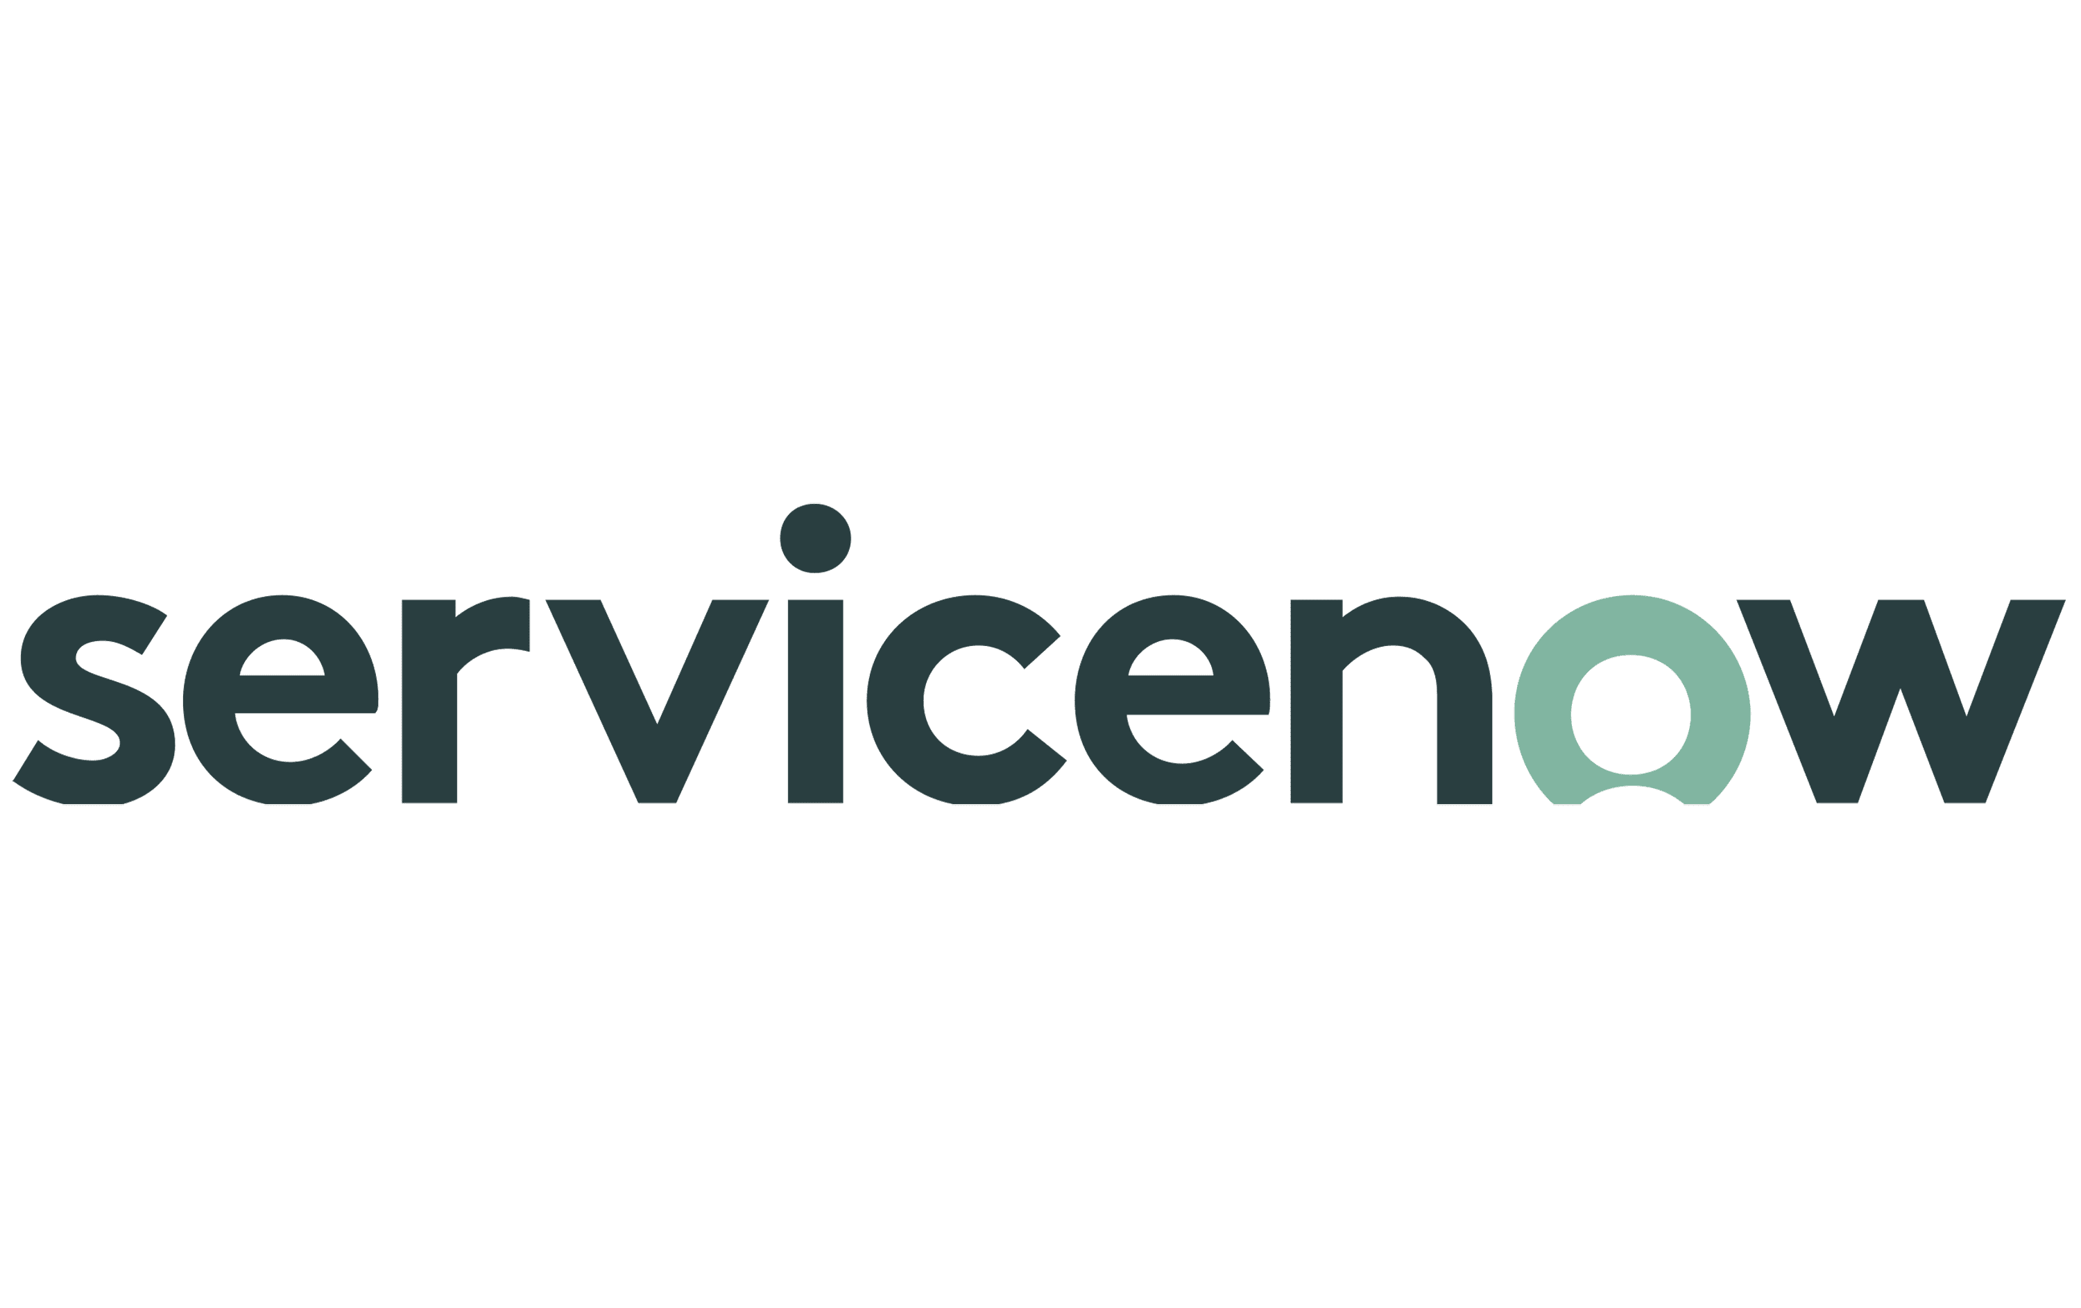
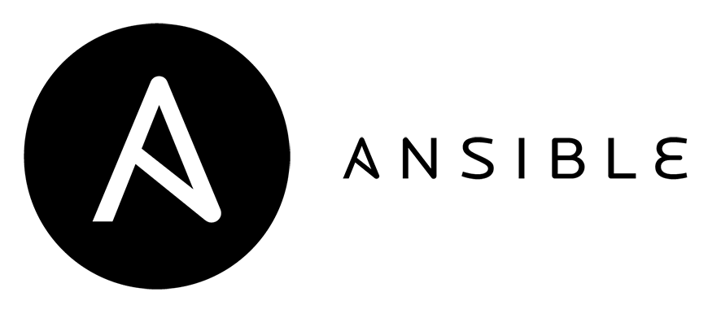


Turbonomic
Technology Partners
New Partner Coming Q2 CY22
Sustainability
Reduce/Minimize Carbon Footprint
Security
Sustainability
Application Performance
Assure Transaction Throughput & Response Times
Infrastructure Provisioning
Deploy Optimal Configurations
Cost
‘Optimization
Turbonomic
Ecosystem
Application
Performance
On Prem & Containerisation
Public Cloud & Containerisation
Workflow Management
Resource Change Approval/Tracking
Workflow
Management
Infrastructure
Provisioning
Cost Optimization
Cloud Cost Mgmt & License Consolidation
Security
Minimize Vulnerabilities
© 2022 Turbonomic, an IBM Company

Slide 16
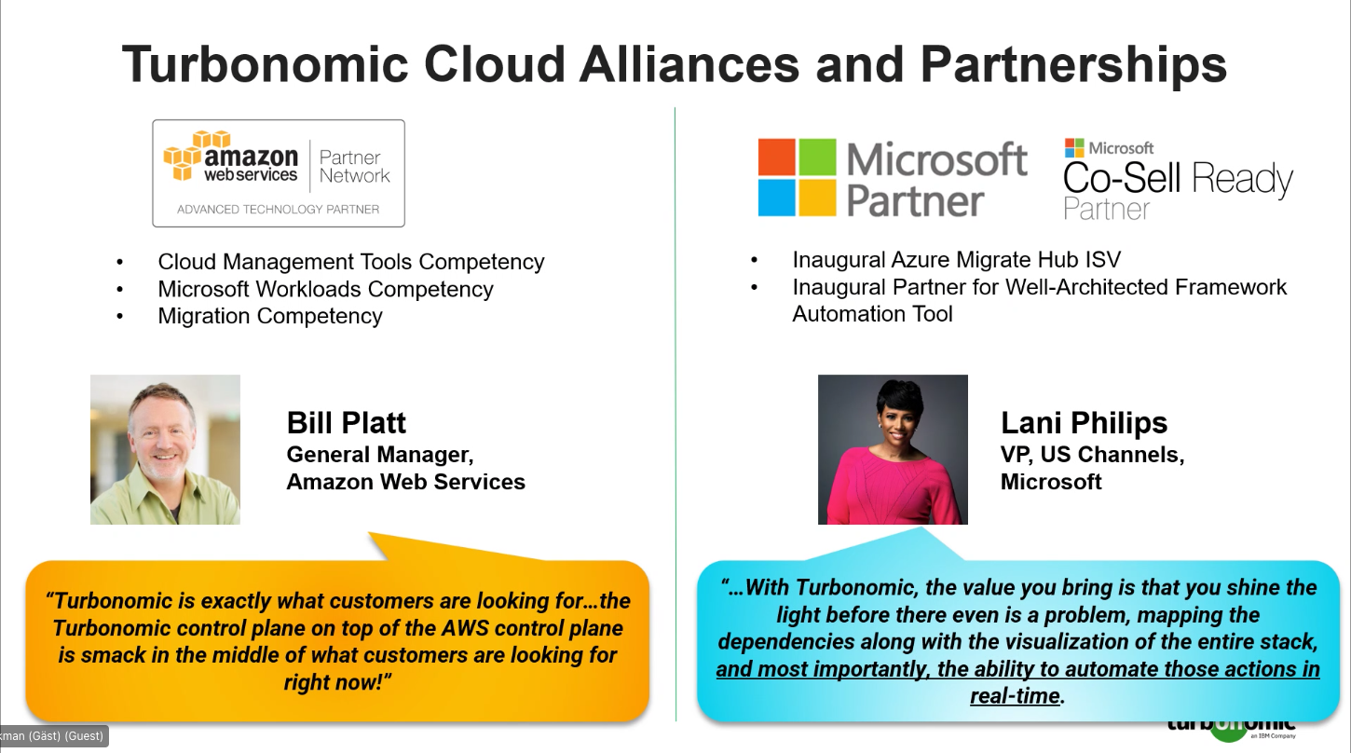

Slide 17





Turbonomic Customers Achieve Real Results
Improve application performance
Faster time to market
Reduce business risk
↑20%
↑40%
↓20%
Improvement to business-critical app availability ¹
Improvement in time-to-market of new services ¹
reduction in Downtime ¹
Reduce cloud spend (& carbon footprint!)
Unite app and infra teams
Increase IT productivity
↓15-20%
↓25%
↑35%
reduction in cloud spend through optimization ¹
Reduction in MTTR ²
Improvement in IT productivity ¹
¹ Forrester Total Economic Impact of Cisco Intersight Workload Optimizer
² IBM and Turbonomic Partner to Help Customers Assure Application Performance in a Multicloud World

Slide 18

Achieving Business Outcomes Through Continuous Trustworthy Actions Better Application Performance and Resiliency, Plus…
Global American Bank
DAILY Automated ACTIONS
~5,000
Recovered capacity
+42%
Banking & Financial Services
DAILY Automated ACTIONS
~8,800
Host:vm Density Improvement
+104%
Global Financial Services
DAILY Automated ACTIONS
~2,200
Improved Application Response Time
90% VDI Wait Time Reduction

Slide 19
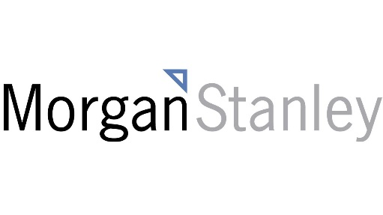
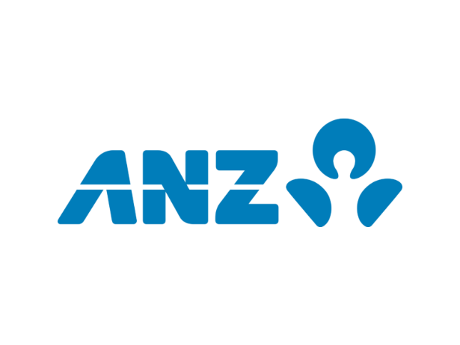









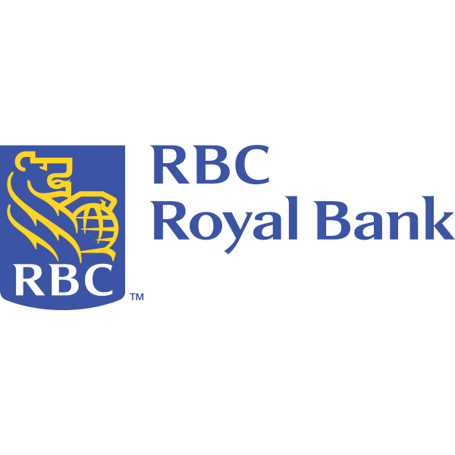
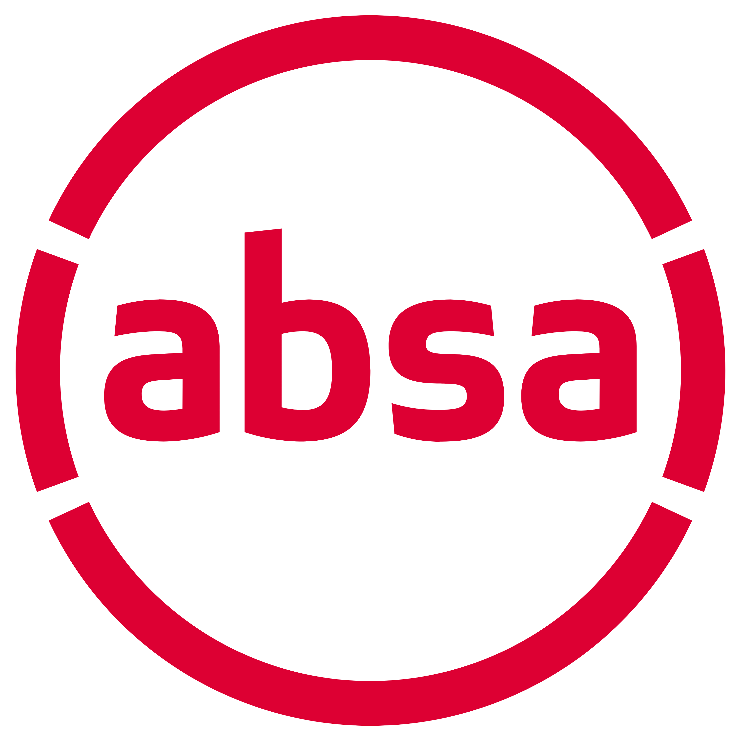

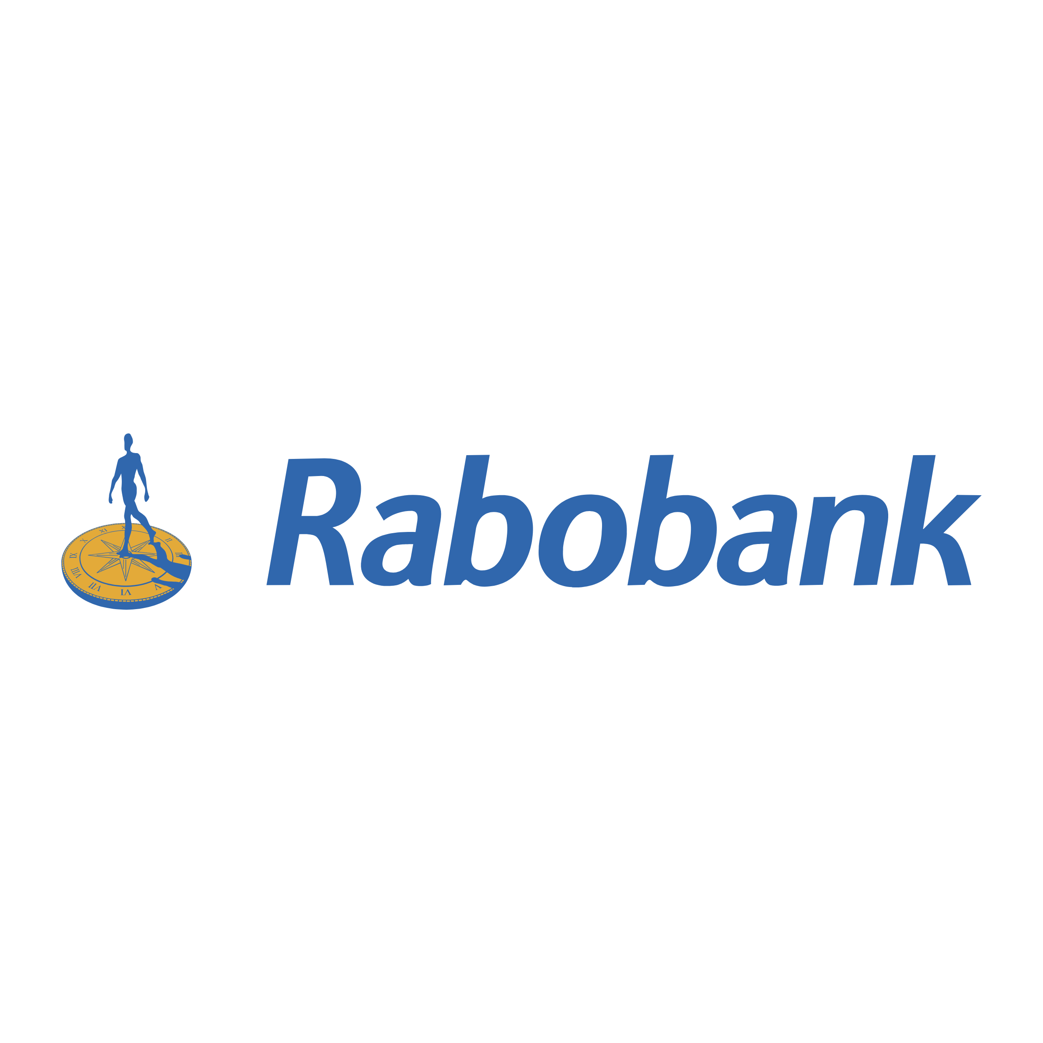



Achieving Business Outcomes Through Continuous Trustworthy Actions
Global American Bank
DAILY Automated ACTIONS
~5,000
infrastructure reduction
42%
Capex savings
-$72m
Banking & Financial Services
DAILY Automated ACTIONS
~8,800
Host Density Improvement +104%
Capex savings
-$27m
Global Financial Services
Daily automated actions
7000
Host density improvement
+50%
Capex Savings
-$38m
Notes:
1. JPMC - Recovered capacity and you can mention $72M in savings or if you want you could put that on the slide.
2. Bank of America - Turbonomic gets application performance metrics from APM (AppD and Dynatrace), enabling significantly higher densities while still achieving their target application service level objectives.
3. Citi Group - Turbonomic enabled their entire customer facing workforce to move to remote work over a weekend and their virtual desktop performance actually got better because Turbo automation made better resourcing decisions at each layer of the stack.

Slide 20














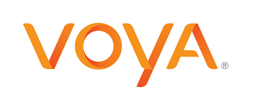





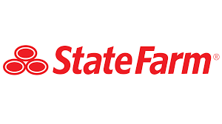






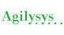






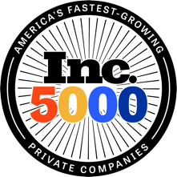
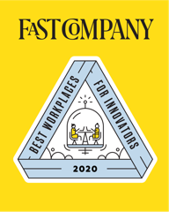


Over 3,000 world-class companies use Turbonomic
Banking
Finance
Technology
Insurance
Healthcare
Communications
Consulting
Retail
Education
Government

Slide 21
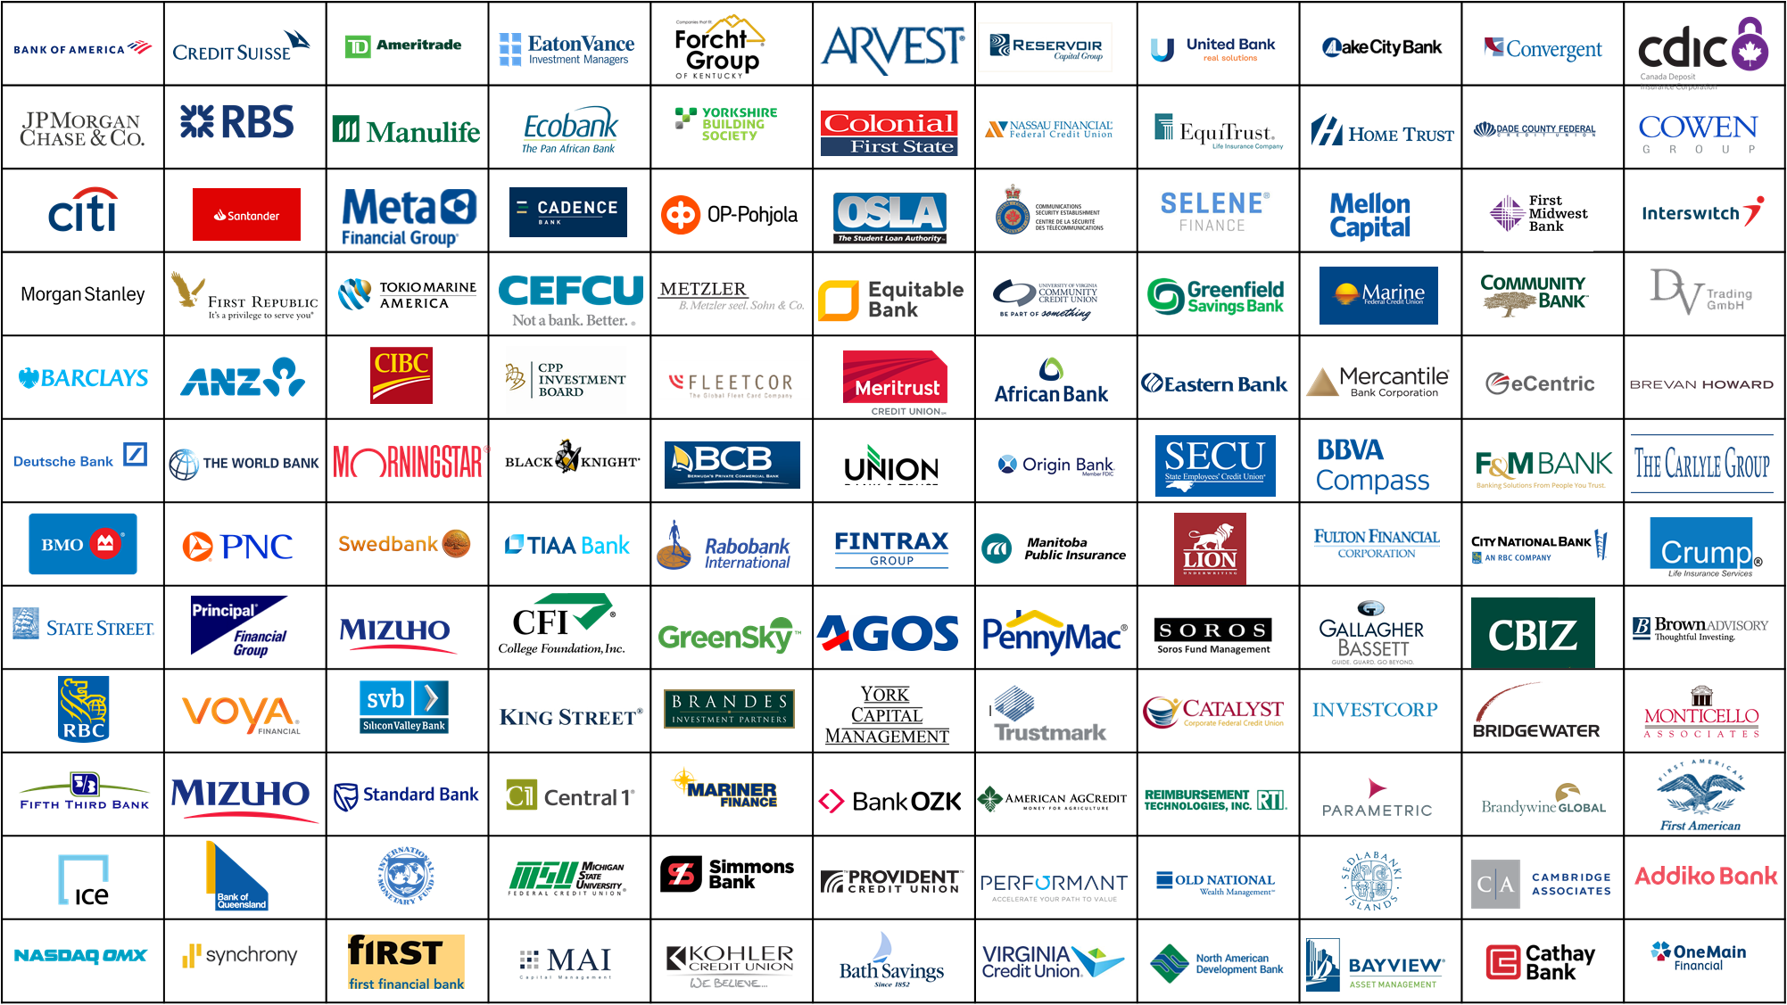



Assuring Performance and driving efficiencies at the following Financial Institutions….
21

Slide 22

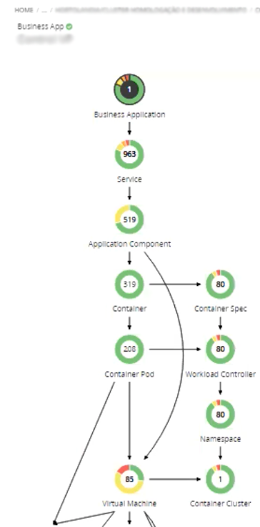
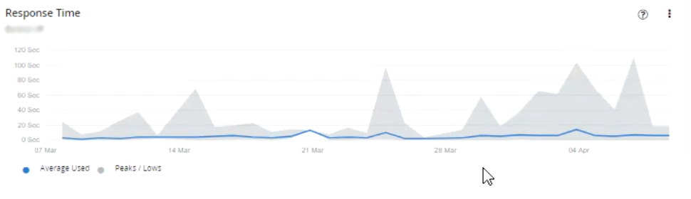
Automation of Application Performance During Peak Demand!
CUSTOMER HIGHLIGHT
57 Mission-Critical Applications
Ex. GPS in car - report theft of vehicle; quote for new policies; etc.
Running on Red Hat OpenShift, GKE, EKS (~7k containers /~3k pods)
Stitched to APM
Automation Reduced Tickets by ~70%
Container resizing (staging)
Continuous placement (all)
This customer is one the largest Insurance companies in South America with over 6 million customers. Their industry standard approach to managing the resourcing of ‘legacy’ and ‘next generation’ environments was slowing down digital transformation and their response to the pandemic.
Turbonomic Automation Kept Response-Time Low
During a Holiday Spike in Demand!
This customer has a business app, which integrates with a one of the largest low-cost airlines operating in the region. Travel insurance is booked from this app so the peak we see on the graph is related to the multi-day Easter holidays. While demand on the app increased, Turbonomic’s dynamic resourcing within the OpenShift platform and the underlying infrastructure was able to keep response-time low.
70%
Reduction in tickets with automation
https://www.turbonomic.com/resources/case-studies/case-study-sulamerica/

Slide 23
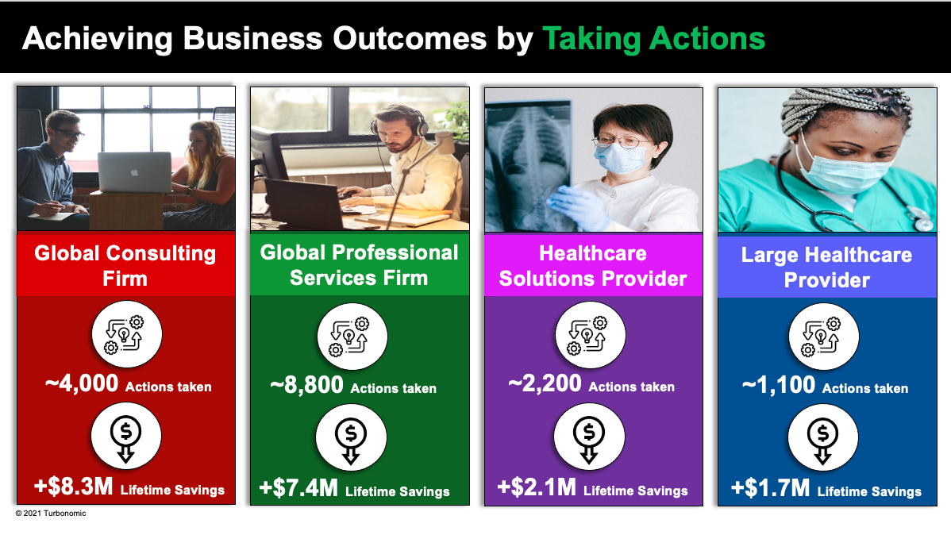

750
$2,500,000
}
}
Cloud accounts
managed by Turbonomic
Turbonomic cloud
migration plans have saved an average of $2.5M per datacenter – Migrated 2 DCs
Lift & Shift v.s Optimised
70%+
Over 70% automated for
VM placement and scaling
30,000+
$12,000,000
VMs (USA, EMEA
& APAC)
Automating Scaling and Storage deletion for IaaS and PaaS – Reached $12M in annual cloud spend savings
Out-of-Band Compliance enforcement in place for optimizing workloads post-deployment
An entire team planning migration of 2 DCs to Cloud, Turbonomic did that in minutes!
Turbonomic is automating sizing actions on pilot accounts and expanding rapidly
Turbonomic identified opportunities to save 40% of cloud spend
Big 4 Accounting Firm

Slide 24



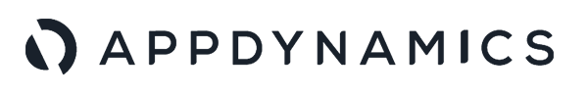
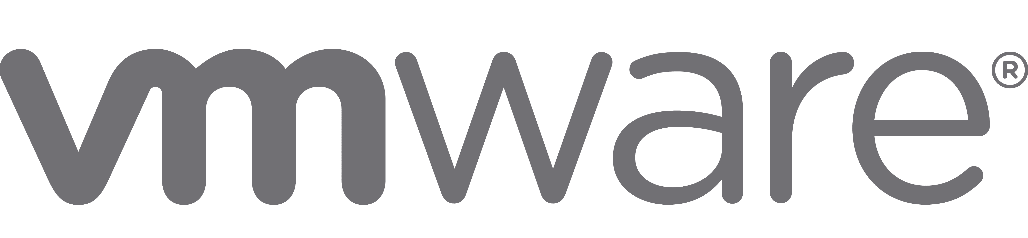
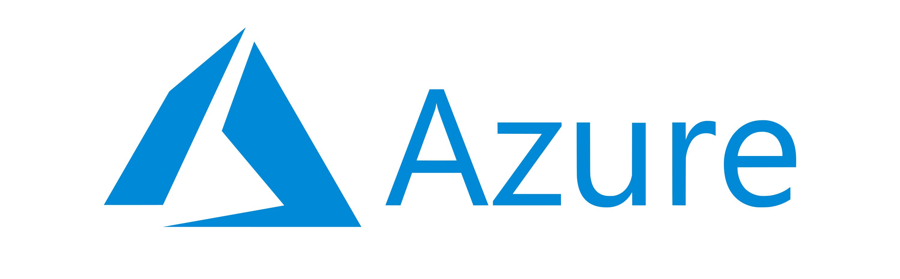

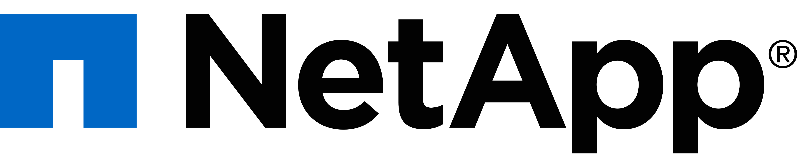
Multinational Professional Services Company Accelerates Cloud Adoption & Achieves $6.6 Million in Cloud Savings
Turbonomic Customer Story
Assure Performance for: 832 subscriptions | 45,000 VMs | 12,500 DBs
Integrations:
42
Onboarded apps
$6.6M
Cloud savings achieved
5,284
Actions executed
$37M
Savings identified
“We have lots of APM, management and monitoring tools but in terms of giving me the exact recommendations what do I need to do and what actions to take, there is nothing like that - except for Turbonomic. Humans are not sustainable for optimization, it requires Turbonomic.”
Director, Cloud Adoption and Optimization
“I noticed my application was slow and remembered Turbo had an action for it. I logged in and immediately found the action reducing my MTTR to a few minutes which would usually take hours.”
Senior Manager
24

Slide 25

Top 5 US-Based Global Bank Sees $27 Million in ROI via Improved Application Performance & Reduction in Tickets
Turbonomic Customer Story
Assure Performance for: 240,000+ VDI | 120,000+ VSI | 100+ OpenShift Clusters | 60,000+ Containers
$27M
in ROI via improved performance and reductions in tickets
14,000
Reduction in vdi tickets per month with 80% reduction in resource requests.
$1M+
Savings in DB licensing
Integrations:
Results
400 Physical ESX hosts suspended over 3 yrs by managing performance instead of OP ratio
$800K Savings in OS Segmentation alone
Over $1M Savings in DB Licensing Segmentation.
Lowered CPU contention by 40%, improving VDI performance by automating 1,000 actions per week, while also improving density by 17%.
Cross-cluster migrations enabled more resiliency and better performance; maintains HA by mitigating IaaS performance risk – VM dynamic placement to avoid resource congestion.
“With the help of Turbonomic we have been able to achieve $27M in ROI via improved performance and reductions in L1 & L2 tickets. We have seen an 80% reduction for resource requests in addition to a reduction of 14,000 tickets PER MONTH!”
MD End User Services
25

Slide 26
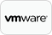














Future-Proof your Hybrid Cloud Optimisation & Automation with Turbonomic
Product Support:
Existing support for these technologies futureproofs customers’ technology decisions
On-Prem DC technologies – VMWare & Hyper-V
Public Cloud vendors – Azure, AWS, GCP
Containerisation – Openshift, Tanzu, AKS, EKS, GKE, K8S Distributions etc…..
Application Observability – Instana, AppD, Dynatrace, NewRelic, App Insights etc…
Commercial model:
Portable licensing model based on workloads – safeguarding any commercial commitment
Google GKE

Slide 27



Next Steps – PoV Approach
Avg ~8.5 Hours Total Time Investment
Define Success
Scope environment, use cases and measurable outcomes
Sign off at both technical and budget holder levels
Get Started
Deploy on prem, in K8s or as SaaS
Add Targets - discover apps, hybrid cloud & containers
Installation Review
Walkthrough of Turbonomic running in your environment
Review success criteria
Business Impact Presentation
Detailed summary of business and technical gains
Leveraging data from PoV

Slide 28
Thank You!

